Slide 1
Tracing the affordances of long-acting injectable depot buprenorphine: a qualitative study of patients’ experiences in Australia¹
Challenges of daily OAT for treating OUD include:
Patient demographics (N=30)
14
16
Weekly or monthly PRB dosing is efficacious and well-tolerated³ but patient-experience data are lacking
Previous OAT:
Single: 47%
Multiple: 53%
Mean age: 47.3 years
Poor adherence¹
Stigma¹
Monthly PRB^{c}
(~33% started on weekly PRB and moved to monthly)
This studyª explored the practical and social benefits and concerns around PRB. Patient perceptions were recorded across five Australian drug and alcohol treatment units^{b}
Prior substance use included:
Semi-structured interviews: Mean ~45 mins^{d}
Heroin: 90%
Methamphetamine: 47%
Rx opioids: 40%
Diversion or non-medical use of takeaway doses^{1,2}
Patients reported PRB-related benefits and concerns vs prior treatment
Selected quotes
Stigma and personal identity
Personal freedoms
Support networks
Dosing control and financial implications
“I don’t have to get up and run into [the clinic…]. I’m starting to look at going back to TAFE [technical and further education college] and stuff like that.”
Liberated from identifying as a “drug addict”
Reduced feeling of being tied to the clinic
Disruption of daily routine
Less feeling of control over personal dosing
Jenny,
age 36
Removal of daily reminder of addiction
Ability to travel without fear or need to arrange treatment
Reduced social support and connection at clinics
Gap in clear patient information about stopping PRB recognised
“[When travelling], I don’t have that issue I have of worrying about am I going to be caught with this medication or questioned why am I carrying it?”
John,
age 50
Reduced risk of stigmatising interactions at clinics
More freedom and control of daily life
Loss of connection made controlling addiction more difficult
Reduced ability to sell takeaway SL buprenorphine doses to generate income^{e}
At first, I missed seeing the nurses in the morning because I always looked forward to saying ‘hello’ and having a chat […]. When I do go in to get a shot [of PRB] I enjoy catching up with them again.
More time/opportunities for new activities
More time for family/ work/study/volunteering
Jane,
age 61
ªQualitative study conducted between 2019 and 2020; ^{b}Units were located in New South Wales and Melbourne, Australia; ^{c}25 patients were recruited from the DEBUT trial, 16/25 received PRB whilst on trial and 9/25 received PRB afterwards. The remaining 5 patients received PRB for the first time within the current study; ^{d}Face-to-face or via telephone; ^{e}Australian dispensing context. OAT, opioid agonist therapy; OUD, opioid use disorder; PRB, prolonged-release buprenorphine; Rx, prescription; SL, sublingual.
1. Barnett A, et al. Drug Alcohol Depend 2021;227:108959; 2. Yokell MA, et al. Curr Drug Abuse Rev 2011;4;28–41; 3. Lofwall MR, et al. JAMA Intern Med 2018 ;178:764–73.

Slide 2
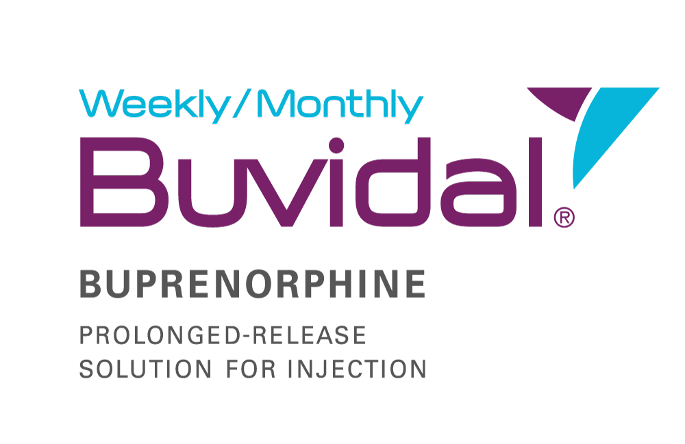
Prescribing Information for Buvidal (buprenorphine prolonged-release solution for injection) Please refer to the Summary of Product Characteristics (SmPC) before prescribing
Active ingredient: Buprenorphine. Prolonged-release solution for injection in pre-filled syringes. Weekly injection (8 mg, 16 mg, 24 mg, 32 mg) or monthly injection (64 mg, 96 mg, 128 mg, 160 mg).
Indication: Treatment of opioid dependence within a framework of medical, social and psychological treatment. Treatment is intended for use in adults and adolescents aged 16 years or over.
Dosage: To avoid precipitated withdrawal, initiate when objective and clear signs of mild to moderate withdrawal are evident, considering the duration of action of the opioid, time since last dose and degree of opioid dependence. Do not start until ≥6 hours after last heroin or short-acting opioid. Reduce methadone to ≤30 mg/day and start Buvidal® ≥24 hours after the last methadone dose. Buvidal® may trigger withdrawal symptoms in methadone-dependent patients. Initiation in patients not already receiving buprenorphine: Patients not previously exposed to buprenorphine, administer 4 mg sublingual buprenorphine and observe for an hour to confirm tolerability. Recommended starting dose of Buvidal® is 16 mg, with one or two additional 8 mg doses at least 1 day apart (target dose of 24 mg or 32 mg during the first week). The dose for the second week is the total dose administered during the first week. May transfer to monthly Buvidal® after four weeks and once stabilised. Switching from sublingual buprenorphine: Switch directly to weekly or monthly Buvidal®, starting on the day after the last sublingual buprenorphine dose. See SmPC for dose recommendations. Maintenance: Weekly or monthly as needed. One supplemental Buvidal® 8 mg dose may be administered between regular weekly or monthly doses (except 160mg). The maximum dose is 32 mg weekly, with an additional 8 mg dose, or 160mg monthly. Weekly doses may be administered up to 2 days before or after the weekly time point, and monthly doses may be administered up to 1 week before or after the monthly time point. If a dose is missed, administer the next dose as soon as practical. Termination: Consider prolonged-release characteristics and any withdrawal symptoms. If switching to sublingual buprenorphine, do so one week after the last weekly dose or one month after the last monthly dose of Buvidal®. Elderly: No dosing recommendations over 65 years. Consider renal and hepatic function.
Administration: Administration of Buvidal® is restricted to healthcare professionals only. For subcutaneous administration only. Inject slowly and completely into sufficient subcutaneous tissue of the buttock, thigh, abdomen, or upper arm area. Do not re-inject the same injection site for at least 8 weeks (each area can have multiple injection sites).
Contraindications: Hypersensitivity to buprenorphine or excipients. Severe respiratory insufficiency. Severe hepatic impairment. Acute alcoholism or delirium tremens.
Special warnings and precautions for use: Must not be administered intravenously, intramuscularly or intradermally. Monitor for any attempts to remove the depot. Some precautions associated with buprenorphine class. Prolonged-release properties of the product should be considered during treatment. Patients with concomitant medicines and/or co-morbidities should be monitored for signs and symptoms of toxicity, overdose or withdrawal. Respiratory depression: Deaths reported with buprenorphine. Care in respiratory insufficiency. CNS depression: Buprenorphine may cause drowsiness. Dependence: Chronic administration of buprenorphine can produce opioid dependence. Serotonin syndrome: Concomitant serotonergic agents (e.g. monoamine oxidase inhibitors, selective serotonin re-uptake inhibitors, serotonin and noradrenaline re-uptake inhibitors or tricyclic antidepressants) may result in serotonin syndrome, a potentially life-threatening condition - if clinically warranted, observe carefully, particularly during initiation and dose increases and consider reducing or discontinuing therapy if serotonin syndrome is suspected. Hepatitis, hepatic events and hepatic impairment: Recording of baseline liver function tests and viral hepatitis status recommended. Hepatic injury reported with buprenorphine. Caution with buprenorphine in moderate hepatic impairment – monitor for signs and symptoms of opioid withdrawal, toxicity and overdose. Monitor hepatic function regularly. Drug withdrawal syndrome (GB): Before starting any opioids, discuss withdrawal strategy with the patient. Dose tapering over weeks or months may be required. Risk of neonatal withdrawal syndrome following use in pregnancy. Precipitation of opioid withdrawal syndrome: Buprenorphine products have precipitated withdrawal symptoms in opioid-dependent patients when administered before the agonist effects from recent opioid use or misuse have subsided. Renal impairment: Caution in severe renal impairment. QT-prolongation: Caution with other medicines that prolong the QT interval and in patients with a history of long QT syndrome or other risk factors for QT prolongation. Acute pain management: A combination of opioids with high mu-opioid receptor affinity, non-opioid analgesics and regional anaesthesia might be necessary. Monitor and titrate, considering potential risk of overdose and/or death. Sleep-related breathing disorders: Opioids can cause sleep-related breathing disorders. Opioid class effects: See SmPC for details. Interactions: See SmPC for buprenorphine interactions. Pregnancy and lactation: Caution – see SmPC for details. Driving and operating machines: Minor to moderate influence, including drowsiness, dizziness or impaired thinking – likely to be pronounced by alcohol or CNS depressants. See SmPC for details of what individual patients should be told by the prescriber.
Undesirable effects: Very common: insomnia, headache, nausea, hyperhidrosis, drug withdrawal syndrome, pain. Common: infection, influenza, pharyngitis, rhinitis, lymphadenopathy, hypersensitivity, decreased appetite, anxiety, agitation, depression, hostility, nervousness, abnormal thinking, paranoia, medical dependence, somnolence, dizziness, migraine, paraesthesia, syncope, tremor, hypertonia, speech disorders, lacrimal disorder, mydriasis, miosis, palpitations, vasodilation, hypotension, cough, dyspnoea, yawning, asthma, bronchitis, constipation, vomiting, abdominal pain, flatulence, dyspepsia, dry mouth, diarrhoea, gastrointestinal disorder, rash, pruritus, urticaria, arthralgia, back pain, myalgia, muscle spasms, neck pain, bone pain, dysmenorrhea, injection site reactions (pain, pruritus, erythema, swelling, reaction, induration, mass), peripheral oedema, asthenia, malaise, pyrexia, chills, neonatal withdrawal syndrome, chest pain, abnormal liver function tests. Other: urinary retention, injection site reactions (abscess, ulceration and necrosis). See SmPC for further details.
Overdose: Apply general supportive measures, closely monitoring and treating respiratory and cardiac status. Consider long duration of action of buprenorphine and prolonged release from the depot.
Package quantities and UK net price: 1 pre-filled syringe per pack. Weekly injection (8 mg (0.16 ml), 16 mg (0.32 ml), 24 mg (0.48 ml), 32 mg (0.64 ml)): £55.93. Monthly injection (64 mg (0.18 ml), 96 mg (0.27 ml), 128 mg (0.36 ml), 160 mg (0.45 ml)): £239.70. Marketing authorisation numbers: GB: PLGB 42800/0001, PLGB 42800/0003-9. ROI and NI: EU/1/18/1336/001-7, EU/1/18/1336/009. Legal category: POM. Marketing authorisation holder: Camurus AB, Ideon Science Park, SE-223 70 Lund, Sweden. Email: Camurus.uk@camurus.com Additional information available on request.
Date of revision: May 2024 FPI-0008
Adverse events should be reported. Reporting forms and information can be found at www.mhra.gov.uk/yellowcard (or search for MHRA Yellow Card in the Google Play or Apple App Store) for the UK and http://www.hpra.ie/homepage/about-us/report-an-issue for Ireland. Adverse events should also be reported to Camurus AB via email: safety@camurus.com
UK-BUV-2400200, May 2024

